Slide 1
CSC3007 Information Visualisation
Lam Zhi Hao, Liang Wei Hao

Slide 2
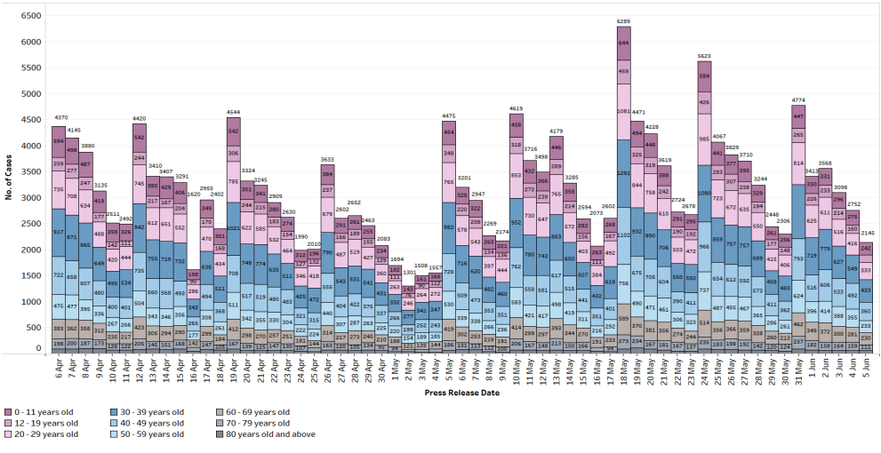

Slide 3


1. Data
Daily press release by MOH on Covid-19 situation
Daily Covid-19 cases
Split by different age group
Notes:
https://www.quora.com/What-are-examples-of-bad-data-visualization-thats-misleading-and-confusing
https://chandoo.org/wp/nightmarish-pie-charts/

Slide 4
2. Task
To inform Singaporeans on the latest Covid-19 situation
To show proportion of infection based on age group
Notes:
https://www.quora.com/What-are-examples-of-bad-data-visualization-thats-misleading-and-confusing
https://chandoo.org/wp/nightmarish-pie-charts/

Slide 5
3. Idiom
Stacked Bar Graph Stacked pie chart for the different age group
Number of Case for Age Group
Displayed inside stacked bar graph segment
Colour
Colour utilized to represent different age group
Total Number of Case
Displayed above stacked bar graph
Notes:
https://www.quora.com/What-are-examples-of-bad-data-visualization-thats-misleading-and-confusing
https://chandoo.org/wp/nightmarish-pie-charts/

Slide 6
4. Suggestion
Filtered view
By age group, date range
Tooltip
Show breakdown of case numbers
Notes:
https://www.quora.com/What-are-examples-of-bad-data-visualization-thats-misleading-and-confusing
https://chandoo.org/wp/nightmarish-pie-charts/

Slide 7
Critique Two Tweet Archivist Desktop

Slide 8
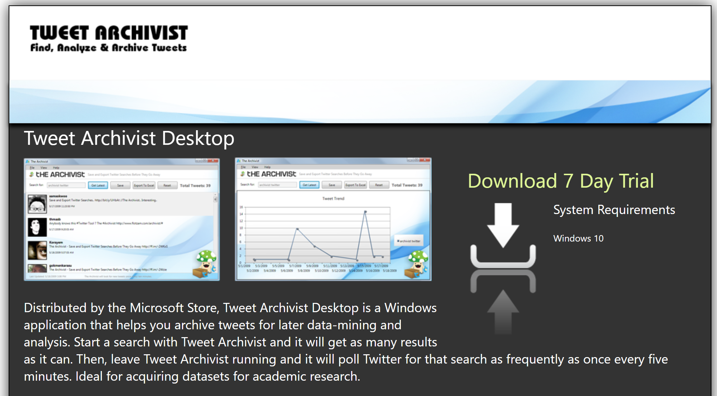

Slide 9
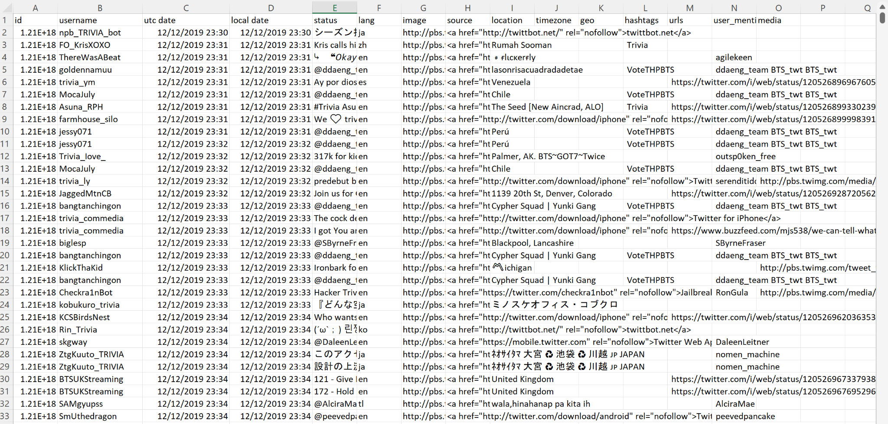
Raw Data

Slide 10
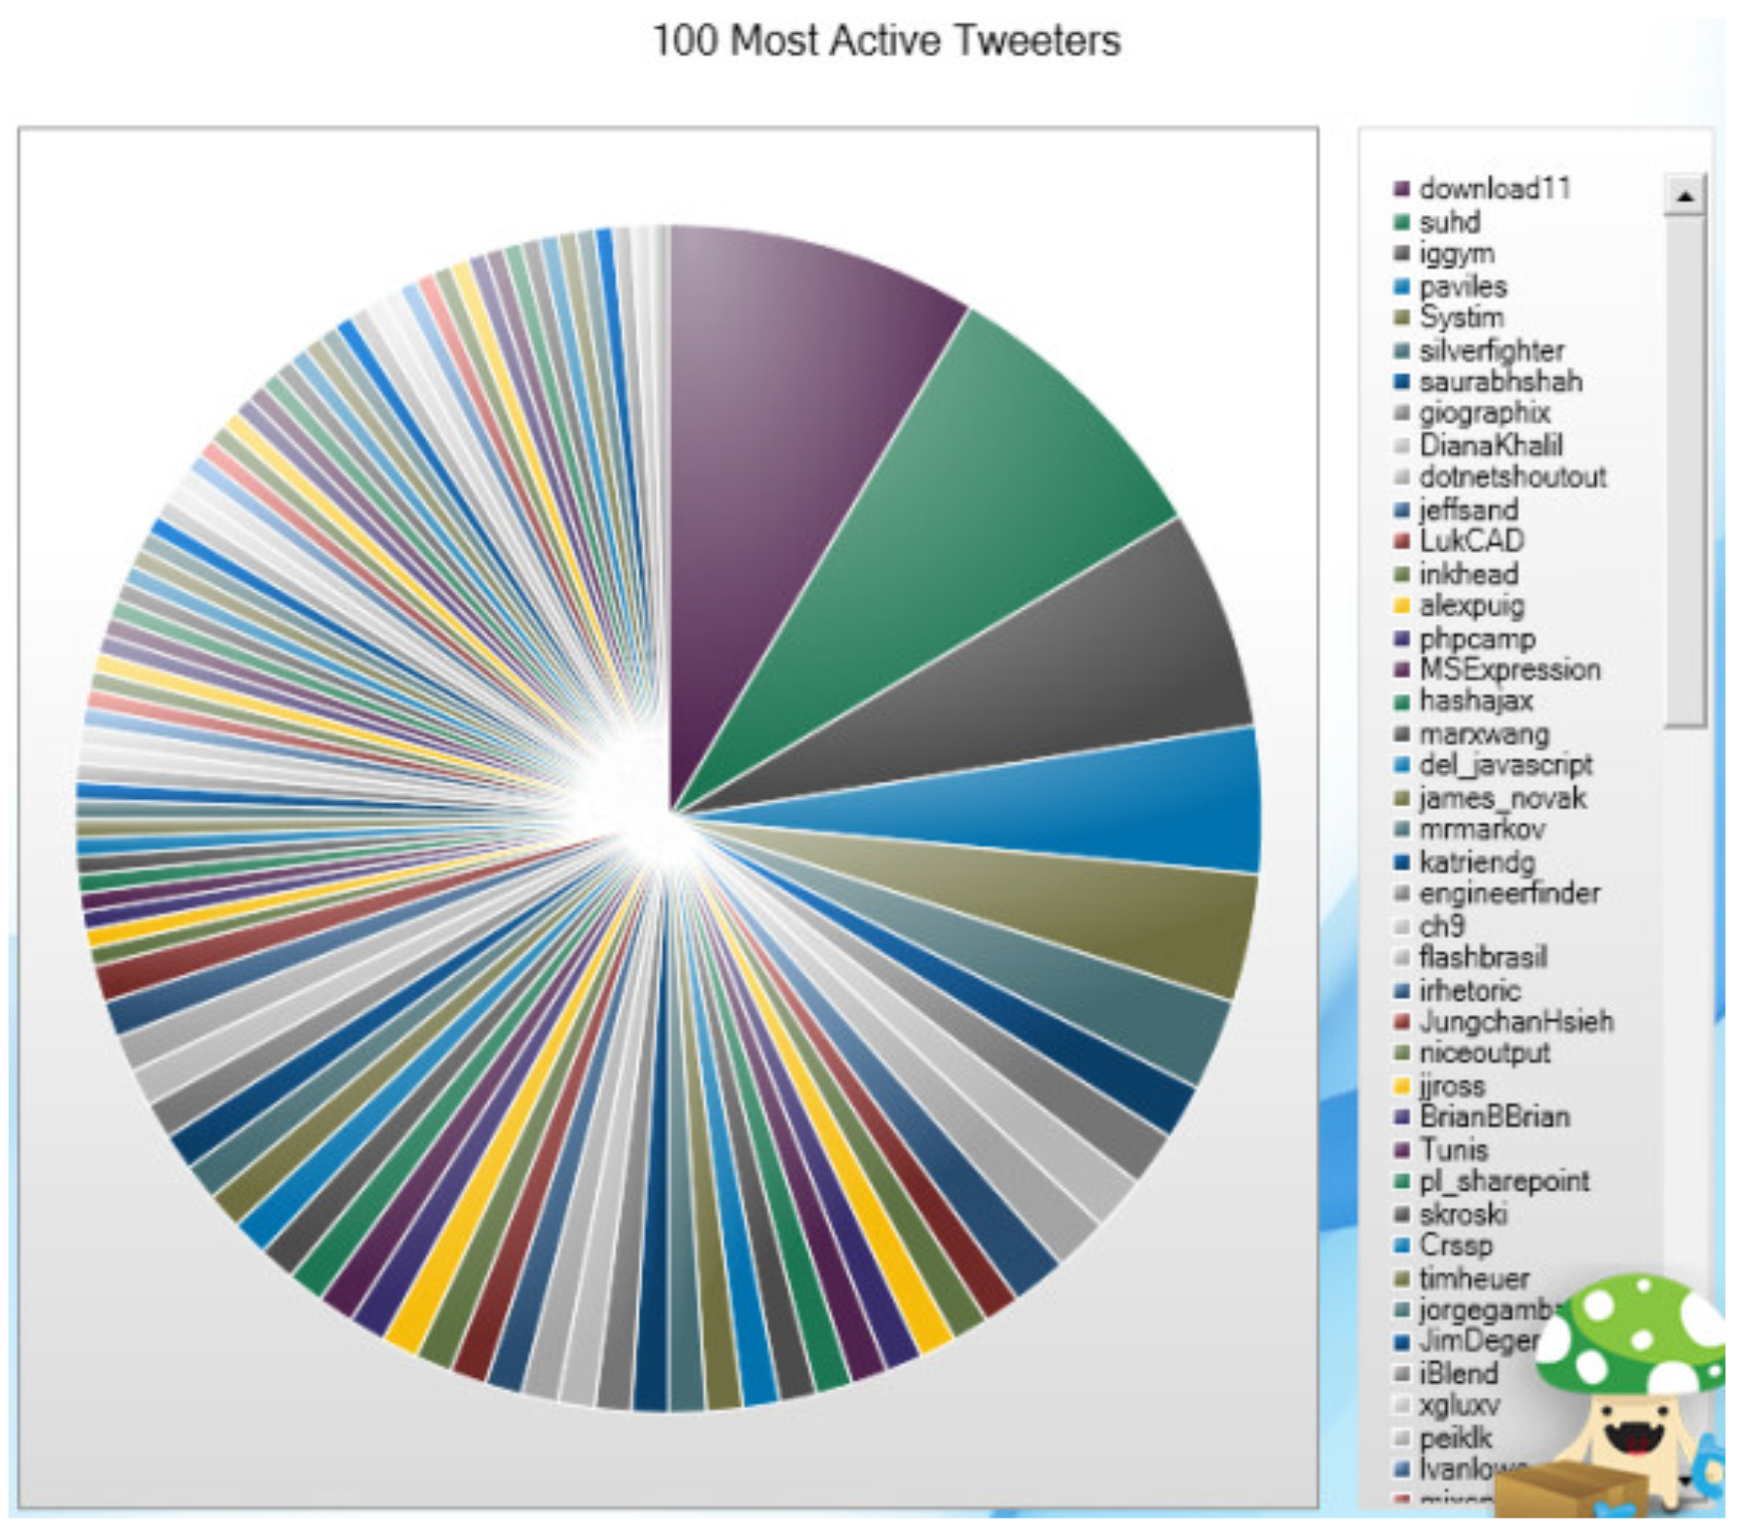
1. Data
Archivist Desktop conducts data mining from twitter and sieved top 100 most active tweeters based on its search criteria
Username 100 most active tweeters
Hidden Percentage / Ratio The list is in descending order
Raw data is available in json and excel format
Notes:
https://www.quora.com/What-are-examples-of-bad-data-visualization-thats-misleading-and-confusing
https://chandoo.org/wp/nightmarish-pie-charts/

Slide 11
2. Task
To create awareness for which tweeter are in the billboard for “Top 100 Most Active Tweeters”
To inform viewers on which tweeter is more active than other
To show proportion ratio on the activeness for each tweeter
Notes:
https://www.quora.com/What-are-examples-of-bad-data-visualization-thats-misleading-and-confusing
https://chandoo.org/wp/nightmarish-pie-charts/

Slide 12
3. Idiom
Pie Chart All 100 most active tweeters are fitted into a single pie chart. Colours are repeated and without any label.
Scrollable List The list is in descending order with repeated colour legend
Cartoon Logo A cartoon logo is located at the bottom right
Notes:
https://www.quora.com/What-are-examples-of-bad-data-visualization-thats-misleading-and-confusing
https://chandoo.org/wp/nightmarish-pie-charts/

Slide 13
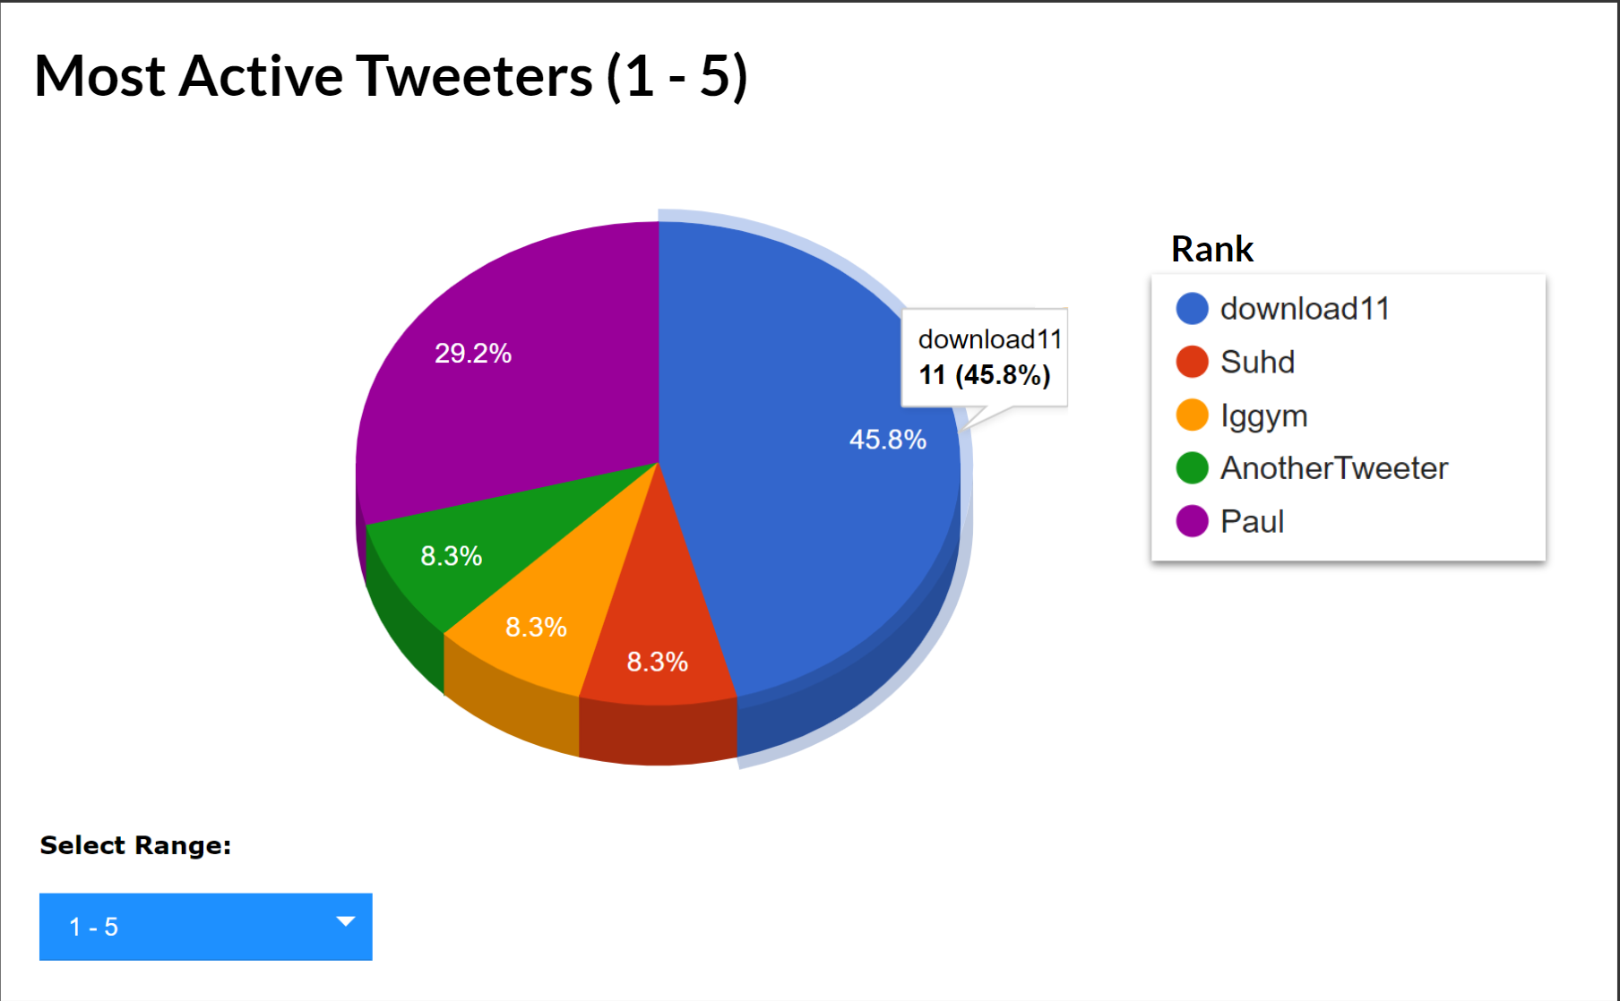
4. Suggestion
Toggleable pie /bar chart showing few records at once
Distinct colour with labels
On hover toolkit for further information
Remove cartoon logo
Notes:
https://www.quora.com/What-are-examples-of-bad-data-visualization-thats-misleading-and-confusing
https://chandoo.org/wp/nightmarish-pie-charts/

Slide 14
Question | Answer Session

Slide 15
Thank you!

